Slide 1
Azure Service Connection User Guide
2023

Slide 2
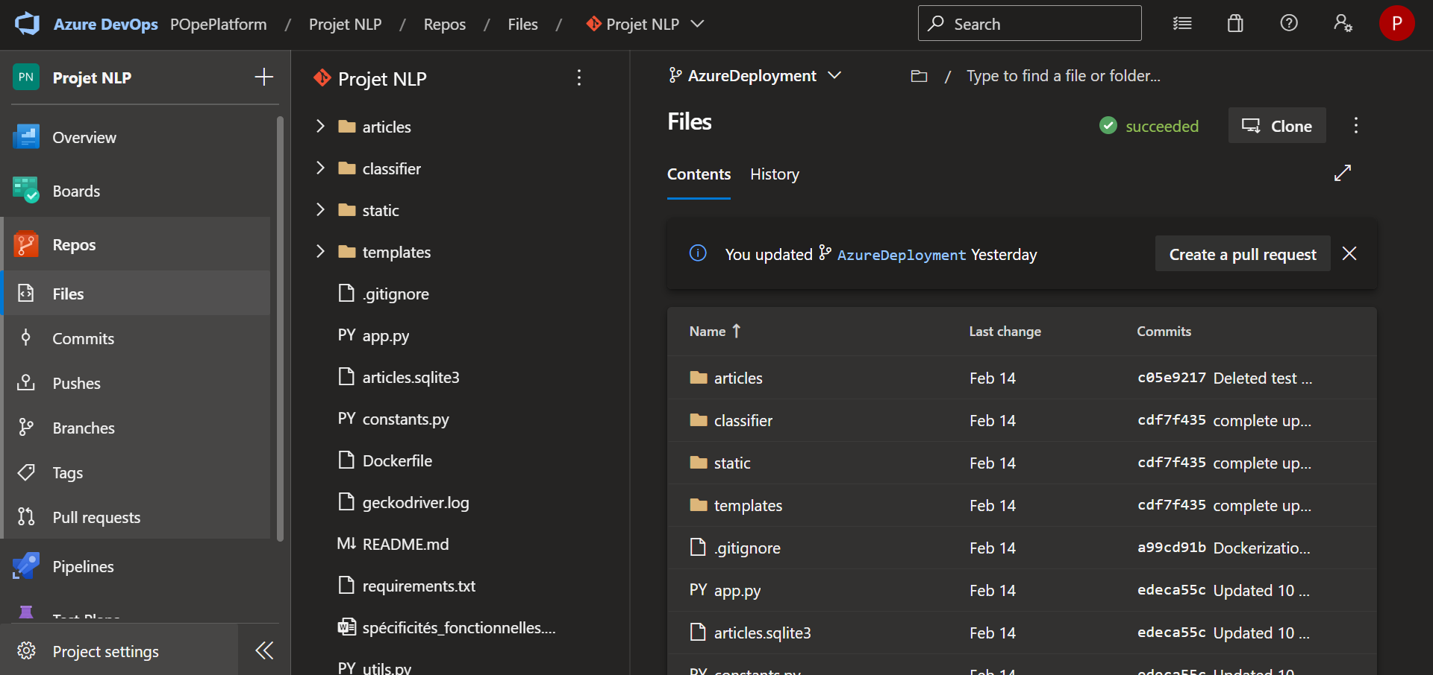
1- Create a Service connection on Azure DevOps
Select your DevOps project
Select Project Settings on the left ribbon

Slide 3
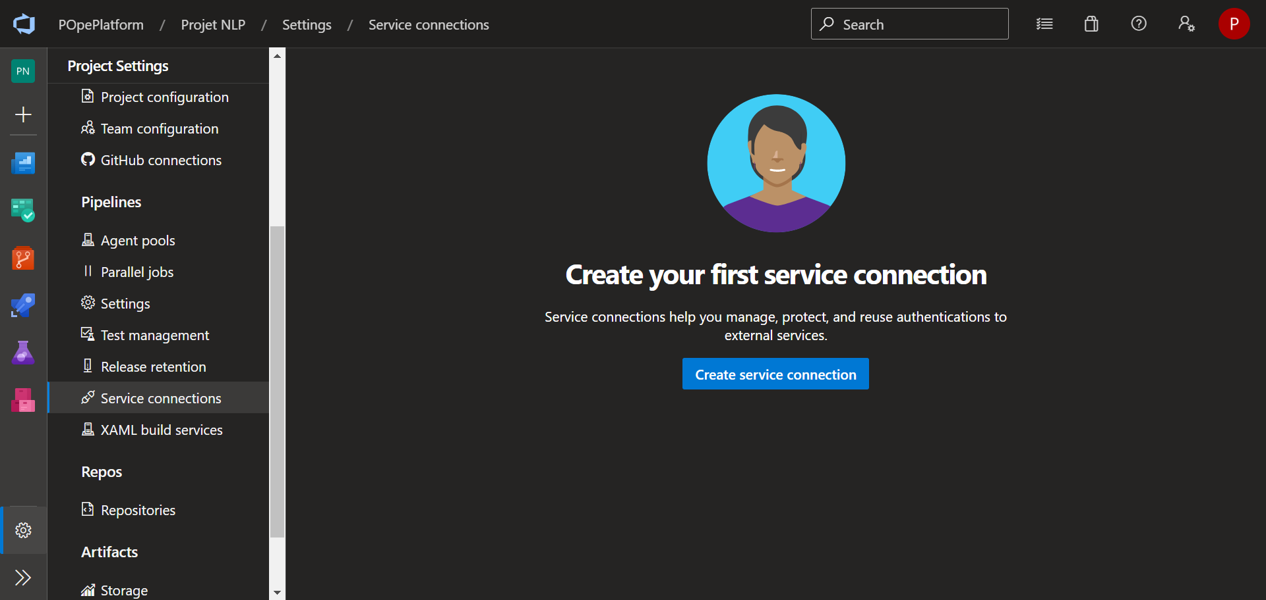
1- Create a Service connection on Azure DevOps
Select Service connections under Pipelines
Select Create service connection

Slide 4
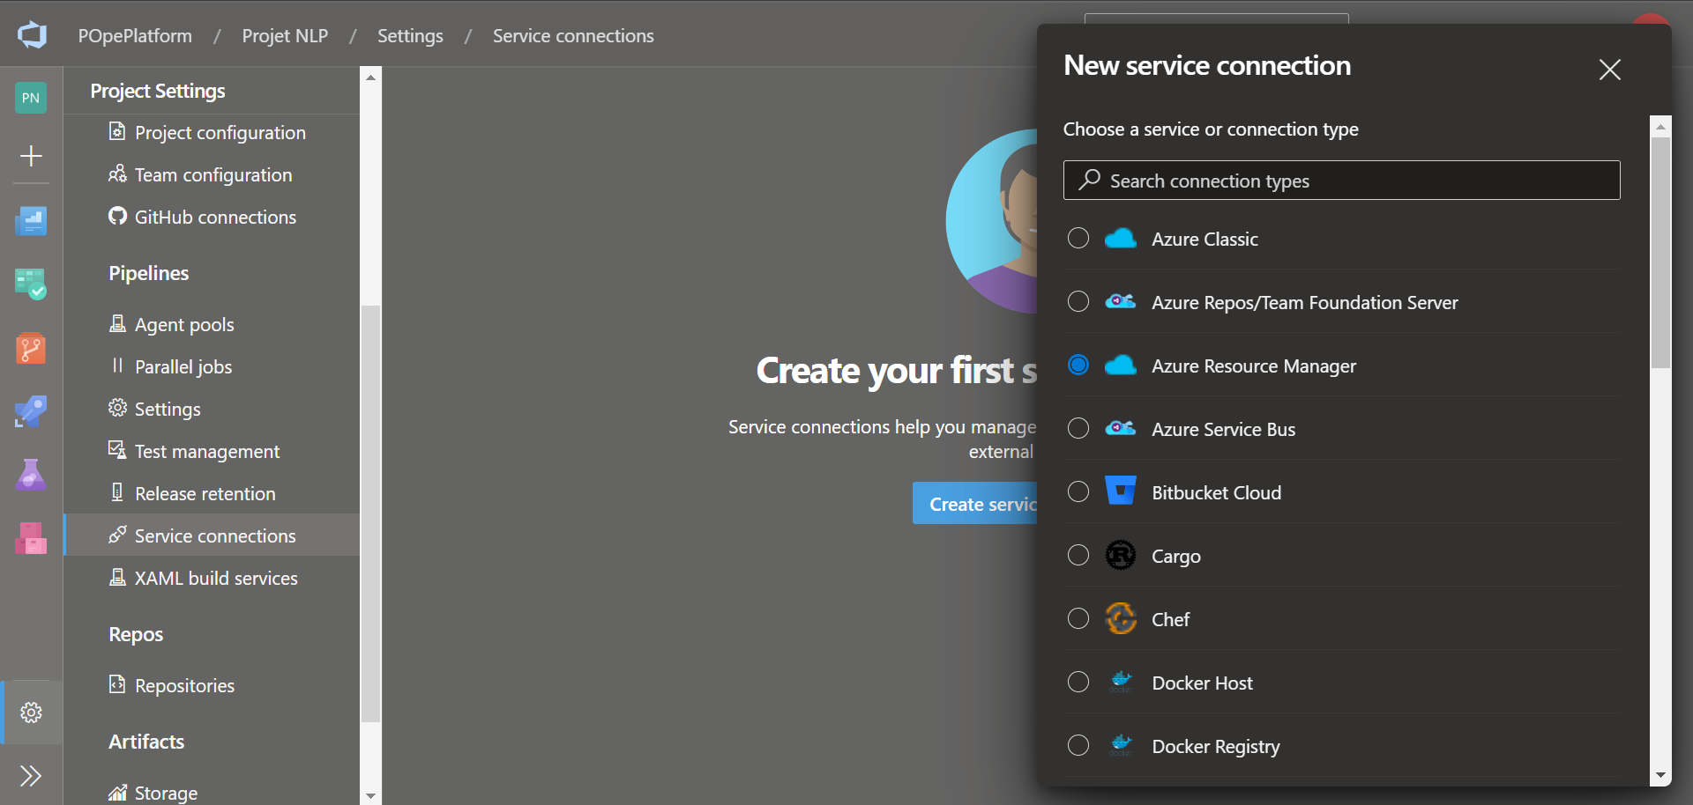
1- Create a Service connection on Azure DevOps
Select Azure Resource Manager

Slide 5
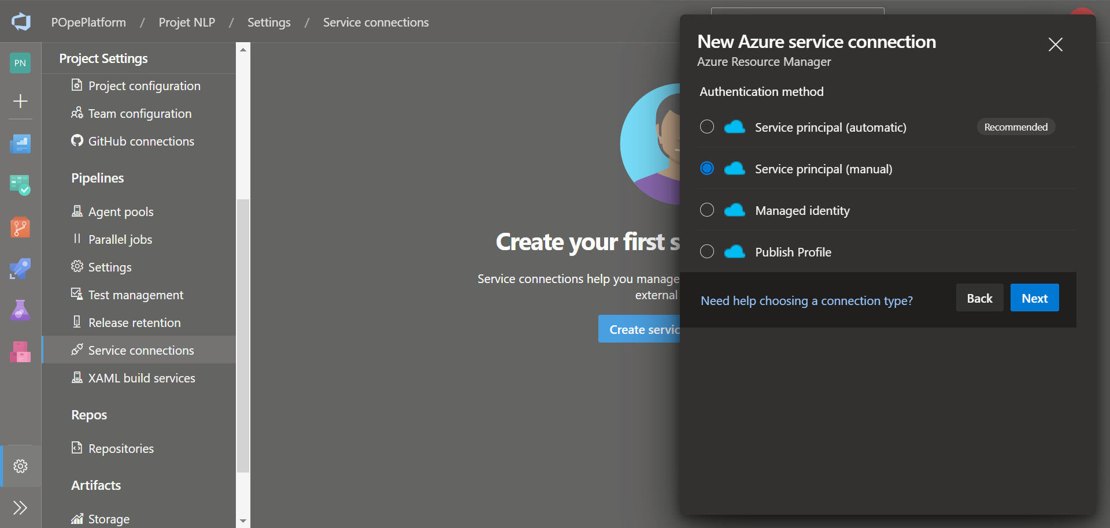
1- Create a Service connection on Azure DevOps
Select Service principal (manual)
Select Next

Slide 6
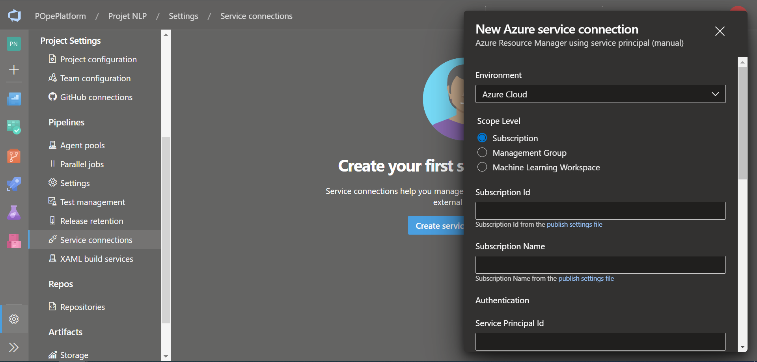
1- Create a Service connection on Azure DevOps
Now you have the form to create a new Azure Service Connection in order to connect your future pipeline
In order to get the necessary informations to complete this form, we will have to connect to the Azure Portal Sanbox and set some authorization settings.

Slide 7
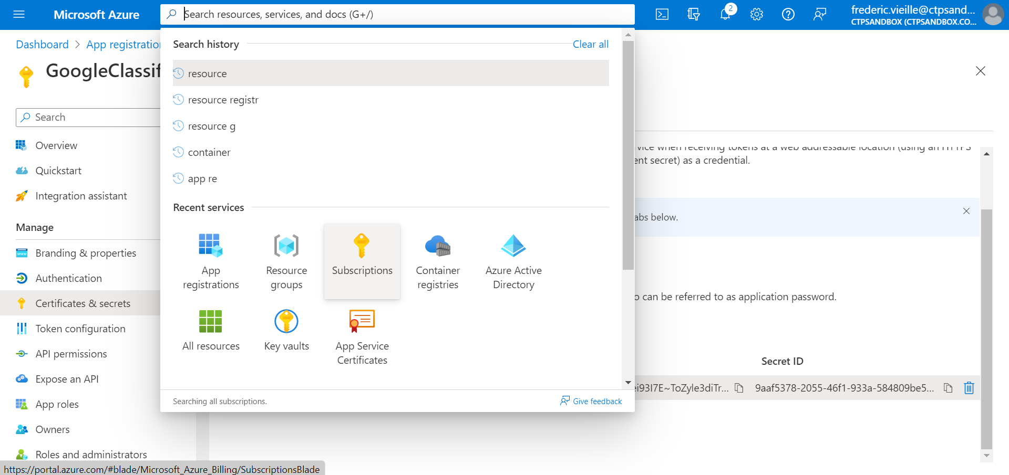
2- How to get the Subscription ID and Subscription Name
Connect to the Azure Portal Sanbox
Select Subscriptions in Azure Portal Sandbox search bar

Slide 8
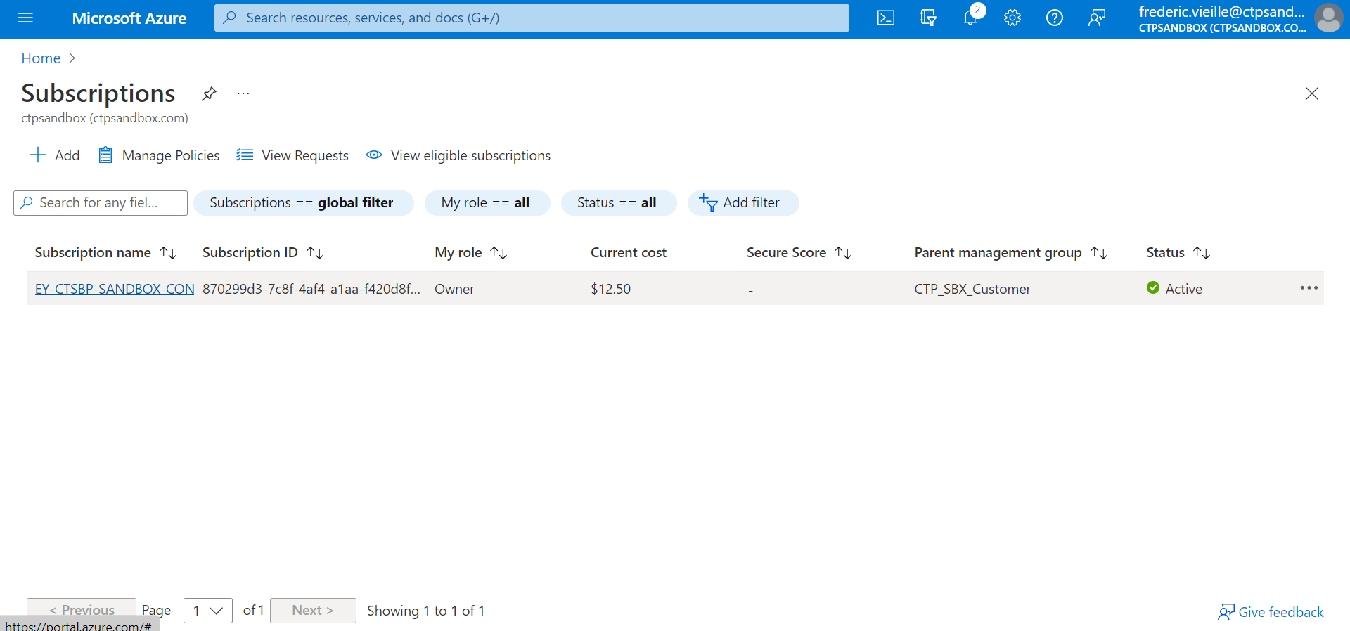
2- How to get the Subscription ID and Subscription Name
Select your subscription

Slide 9
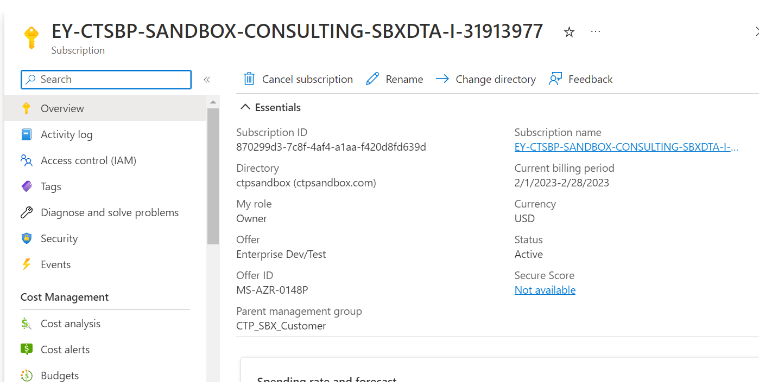
2- How to get the Subscription ID and Subscription Name
Select the Overview ribbon
Note the following informations :
Subscription ID
Subscription name

Slide 10
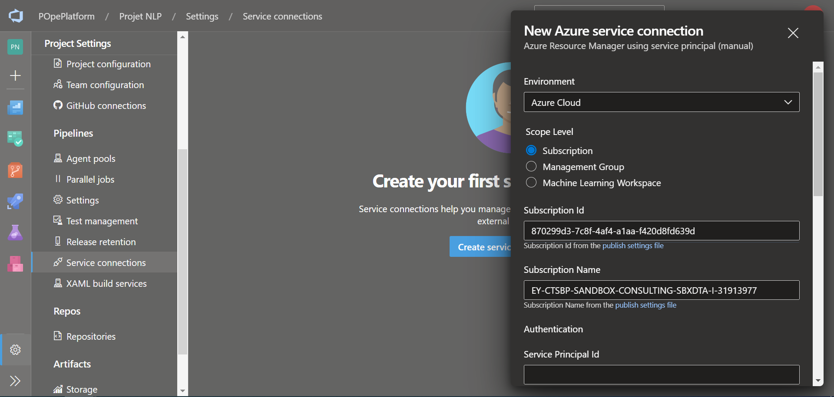
2- How to get the Subscription ID and Subscription Name
Go back to you Azure DevOps form
Enter the following fields :
Subscription ID
Subscription Name

Slide 11
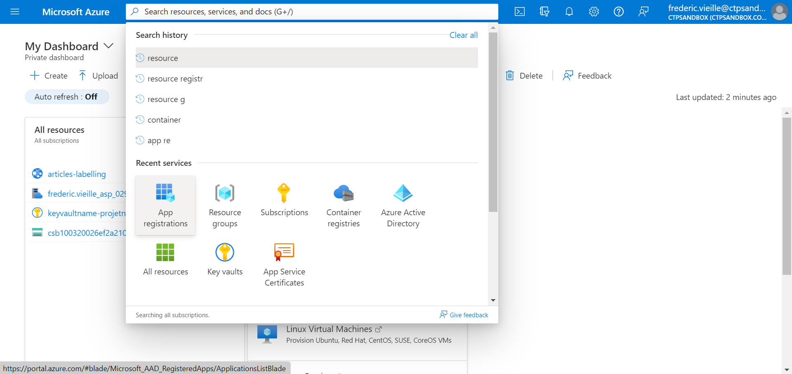
3- How to create an App registration
Go back to the Azure Portal Sandbox
Select App registration in the search menu

Slide 12
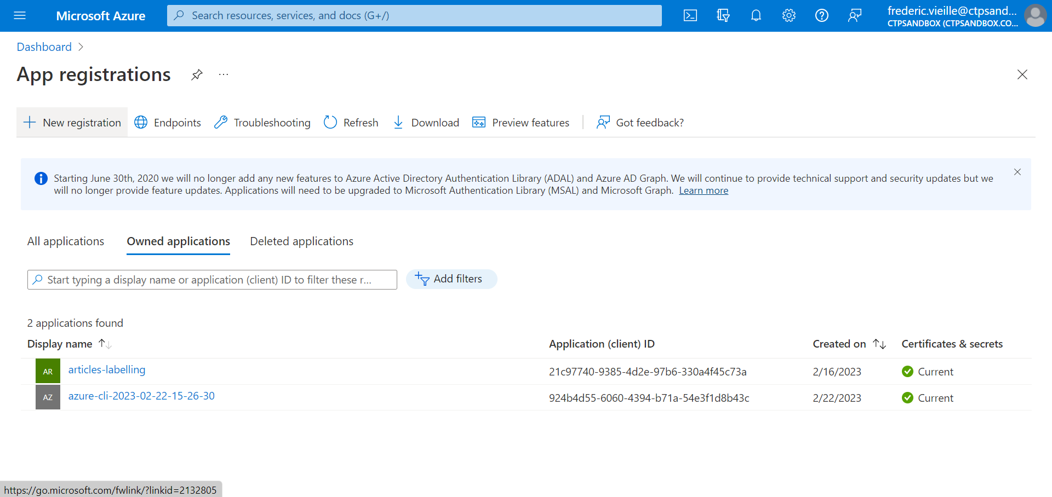
3- How to create an App registration
Select + New registration

Slide 13
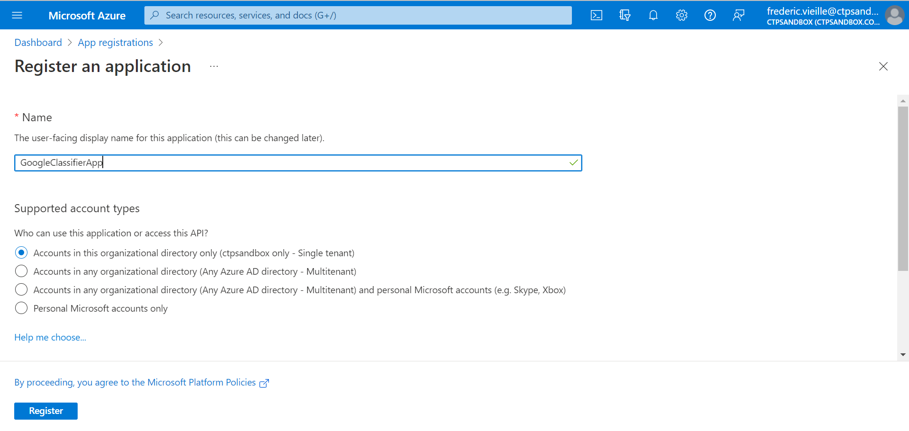
3- How to create an App registration
Enter a Register app name
Select Register

Slide 14
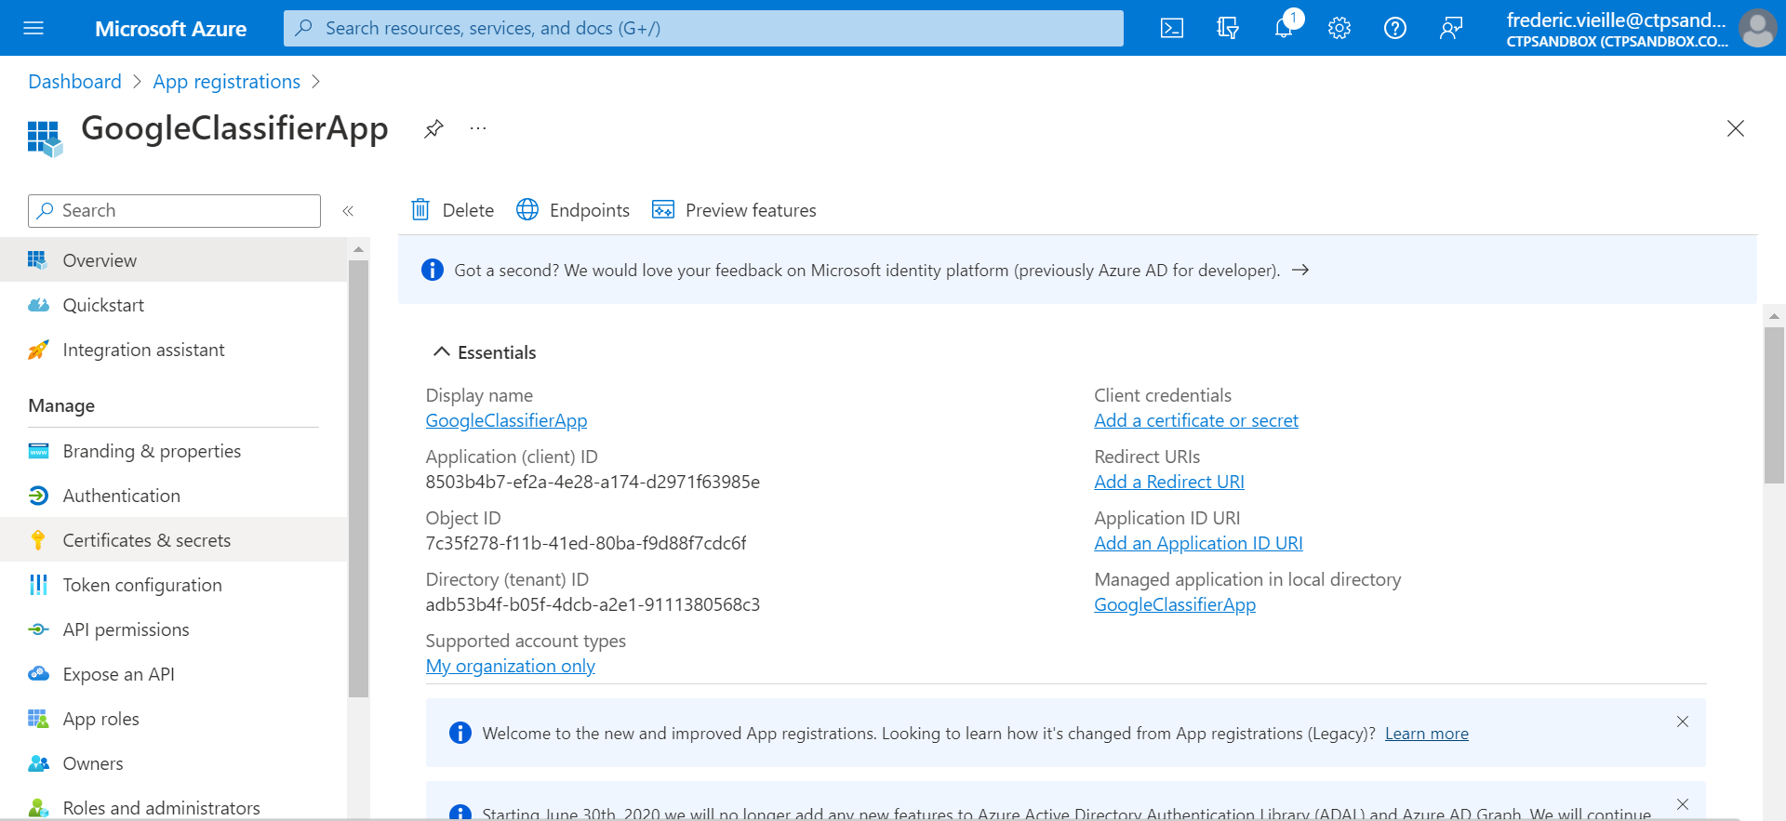
3- How to create an App registration
Now you have access to two new information for your DevOps form.
Note the following ID’s :
Application (client) ID
Directory (tenant) ID

Slide 15
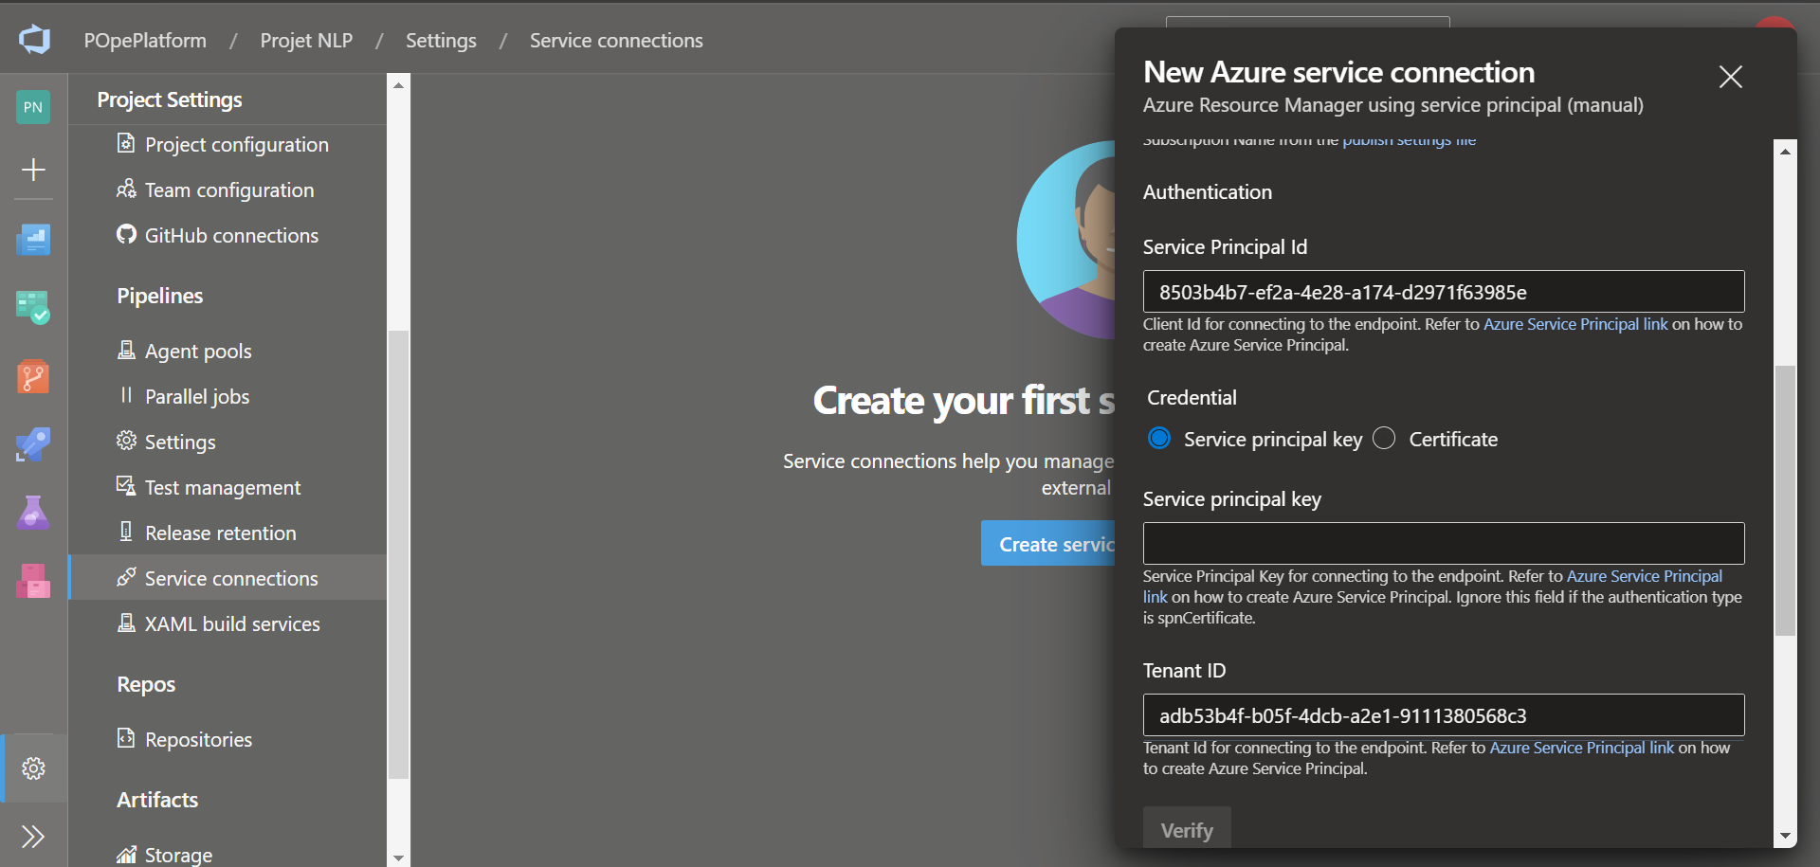
3- How to create an App registration
Go to your Azure DevOps form
Enter the following fields :
Service Principal ID : previous Application (client) ID
Tenant ID : previous Directory (tenant) ID

Slide 16
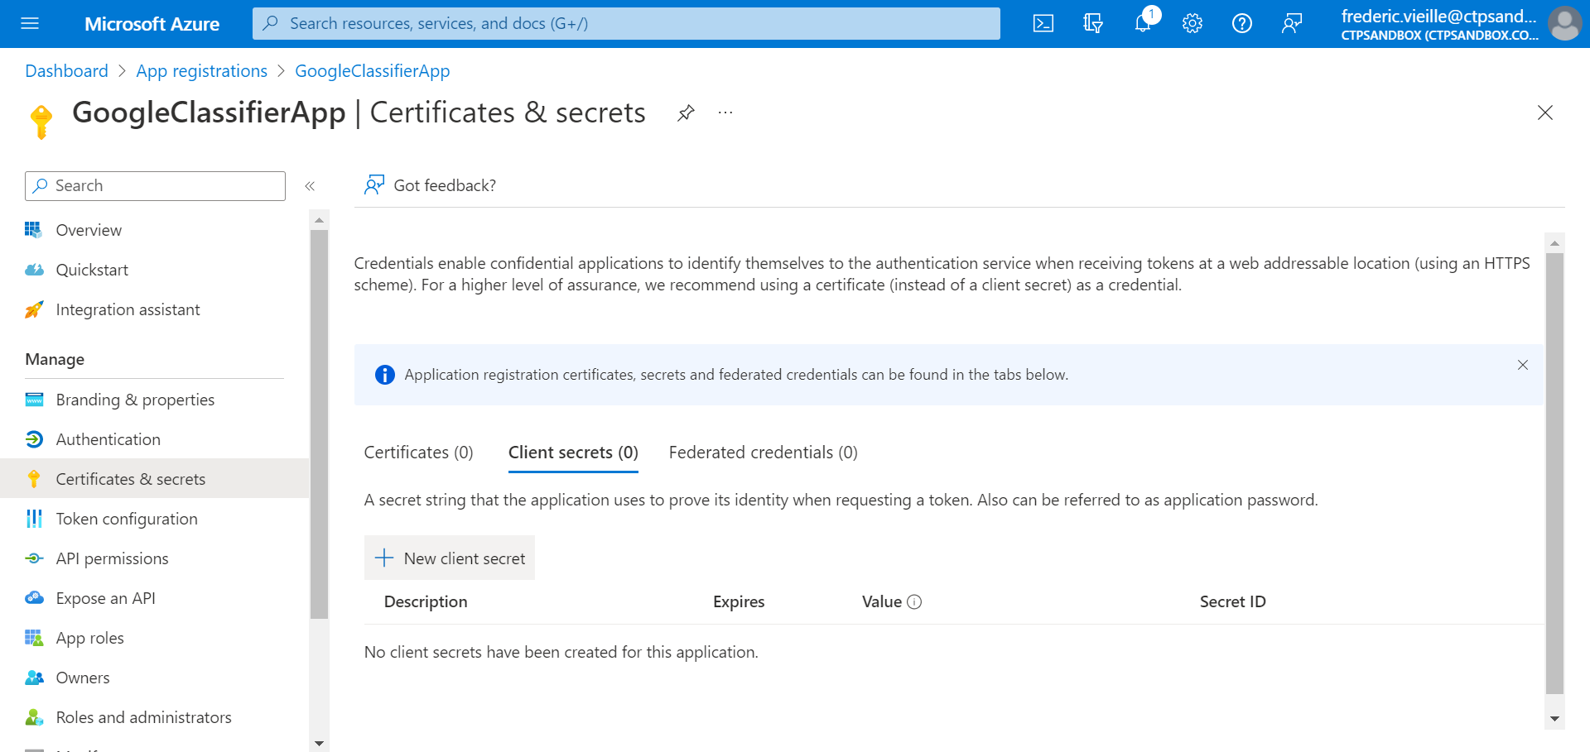
4- How to create a client secret
In order to get the Service principal key we will have to create a last resource.
Go to your Azure Portal Sandbox
Go back to the App Registration you have created
Select Certifications & secrets in the left ribbon
Select Client secrets
Select + New client secret

Slide 17
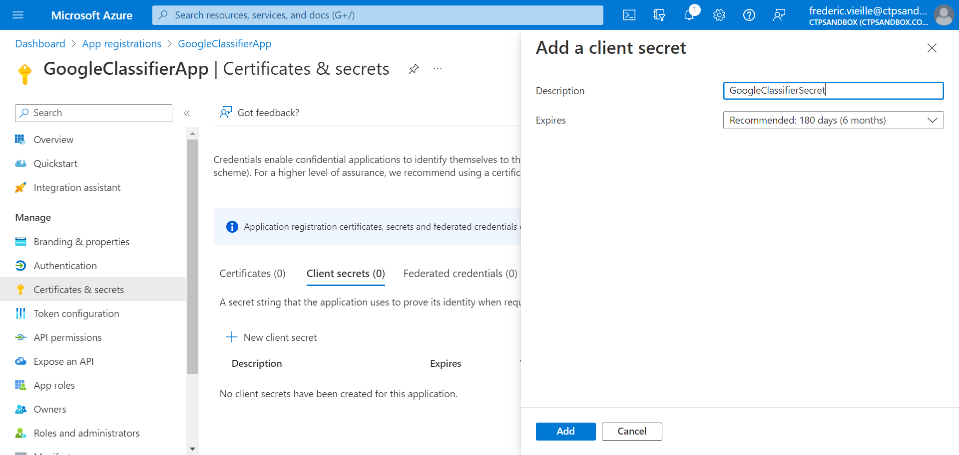
4- How to create a client secret
Enter a Description to your client secret
Select Add

Slide 18
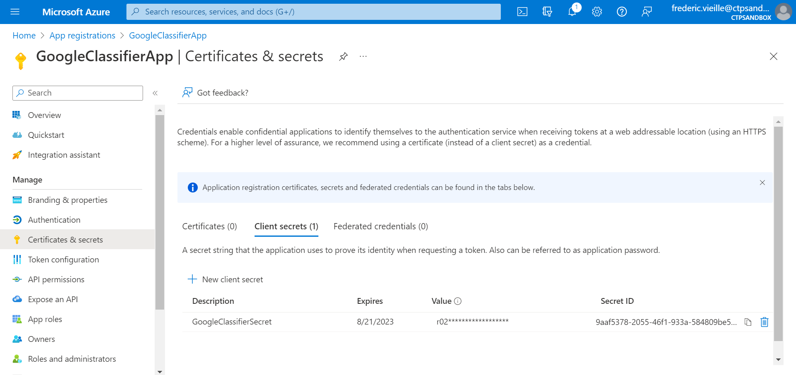
4- How to create a client secret
Note the Value for your new key
Important : You will not be able to view this value again so keep it if necessary.

Slide 19
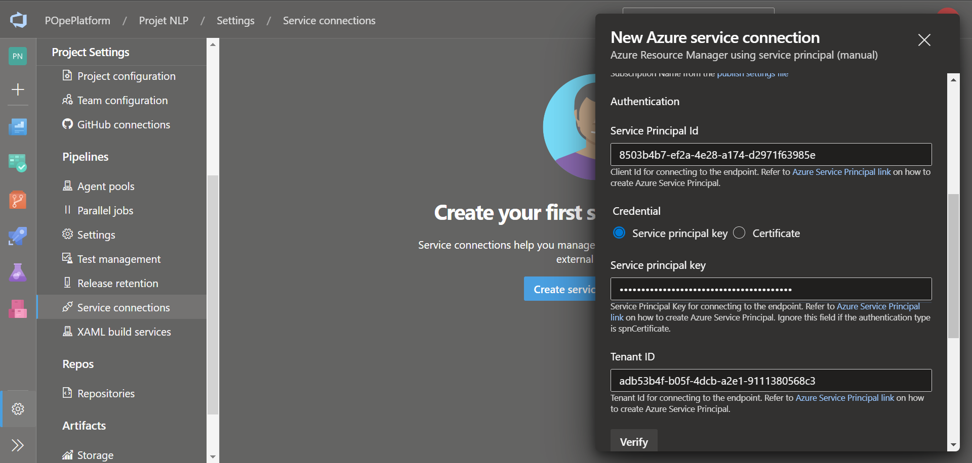
4- How to create a client secret
Go to your Azure DevOps form
Enter the key value you previously created in the field Service principal key

Slide 20
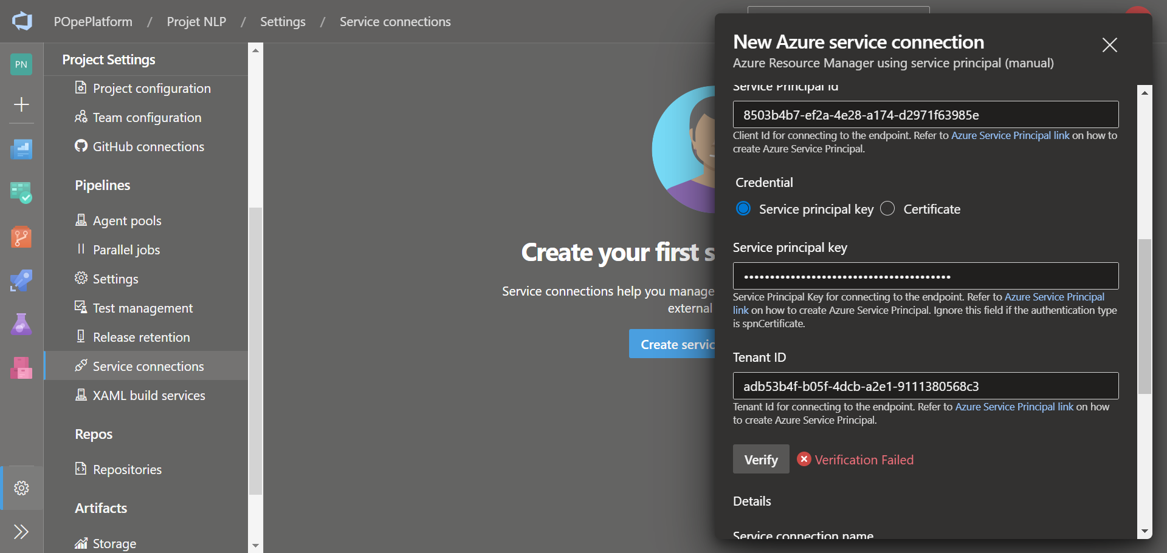
4- How to create a client secret
Try the Verify option under Tenant ID
The verification will fail, we are missing some authorization

Slide 21
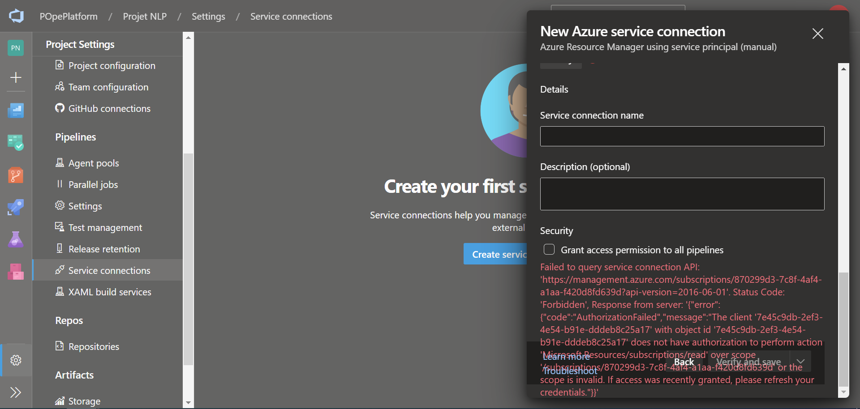
4- How to create a client secret
The error will show up on the bottom of the form, can be useful in case of unexpected errors.

Slide 22
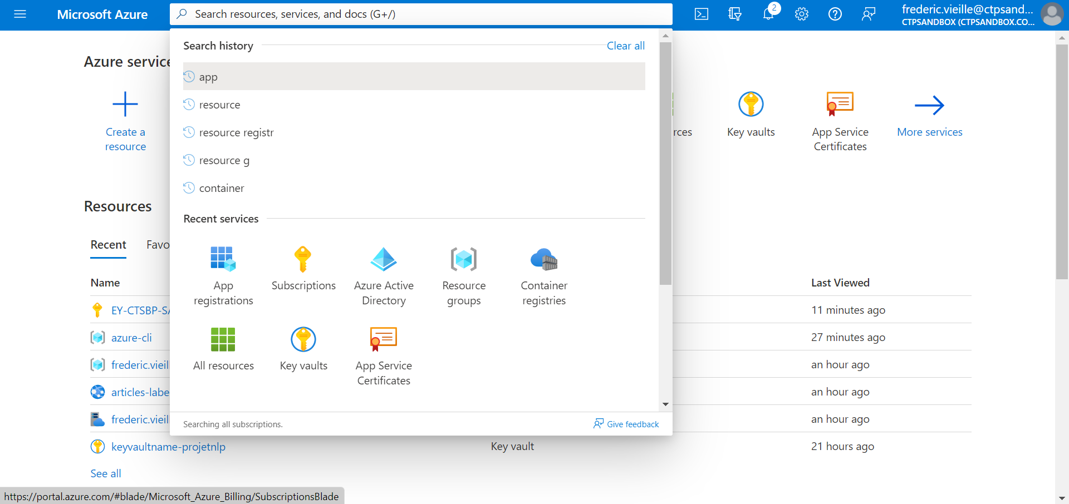
5- How to grant your Application registration
Go to the Azure Portal Sandbox
Select Subscriptions in the search bar

Slide 23

5- How to grant your Application registration
Select your subscription

Slide 24
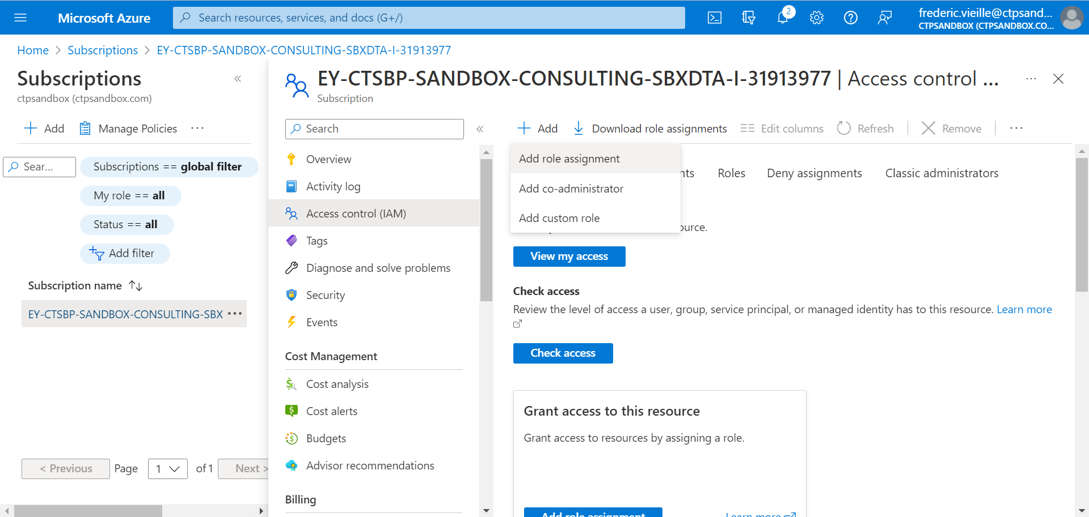
5- How to grant your Application registration
Select Access control (IAM) on the left ribbon
Select + Add and Add role assignment

Slide 25
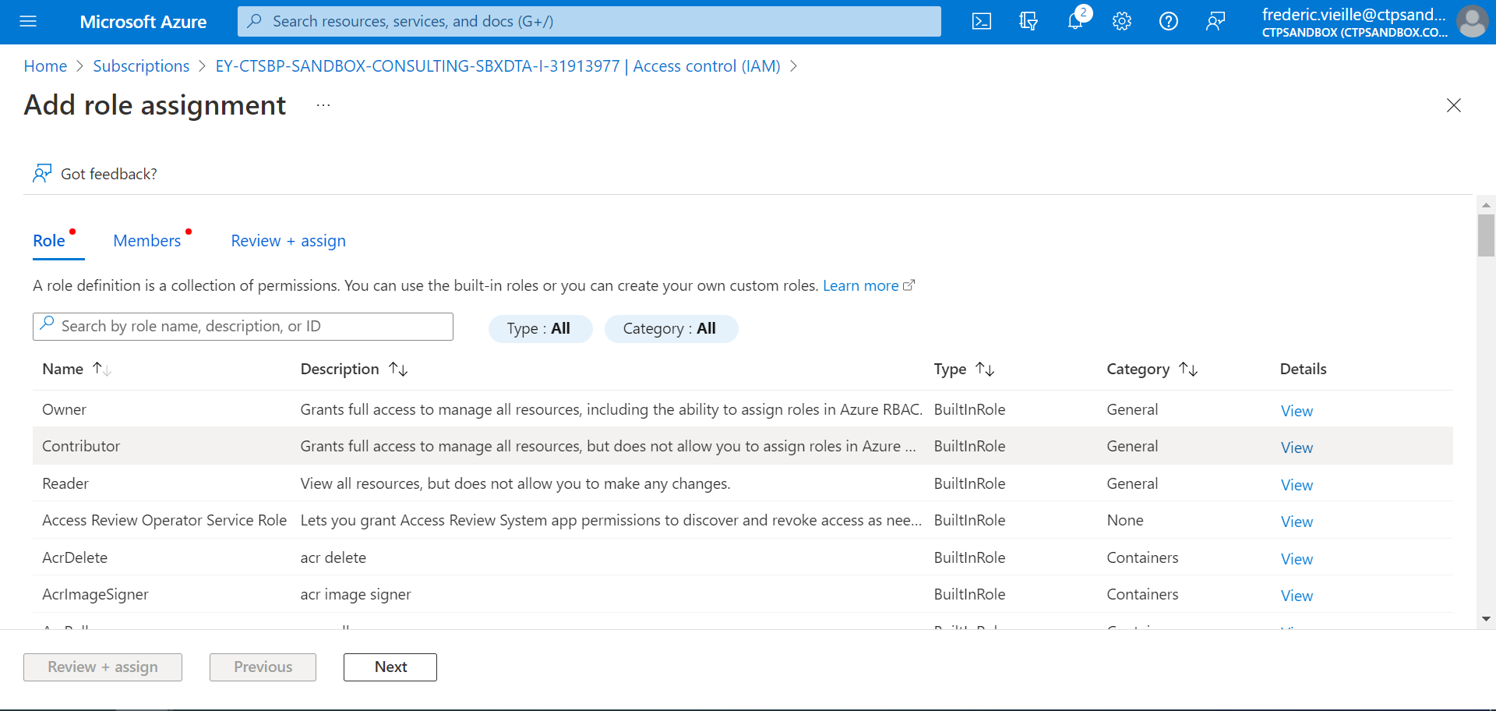
5- How to grant your Application registration
Select Contributor
Select Next

Slide 26
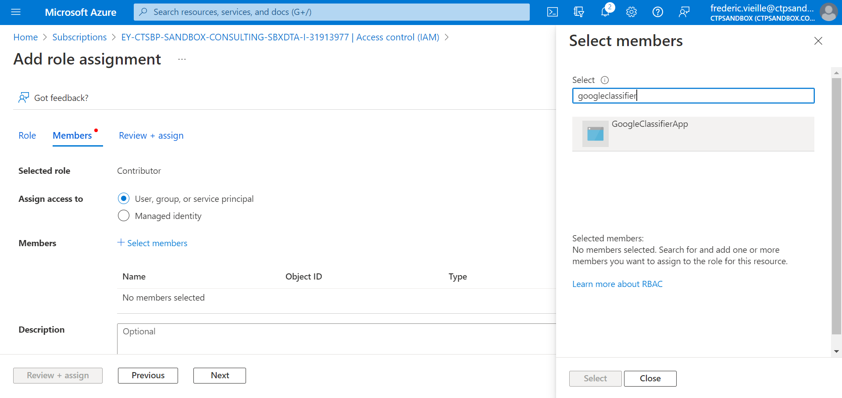
5- How to grant your Application registration
Click on + Select members
Enter the name of your previously created Application Registration in the right ribbon search bar
Select your Application Registration
Click Select

Slide 27
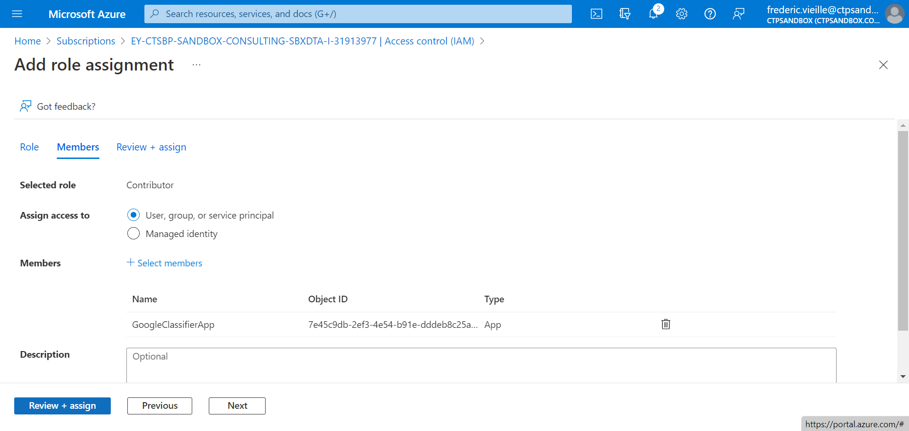
5- How to grant your Application registration
Select Review + assign

Slide 28
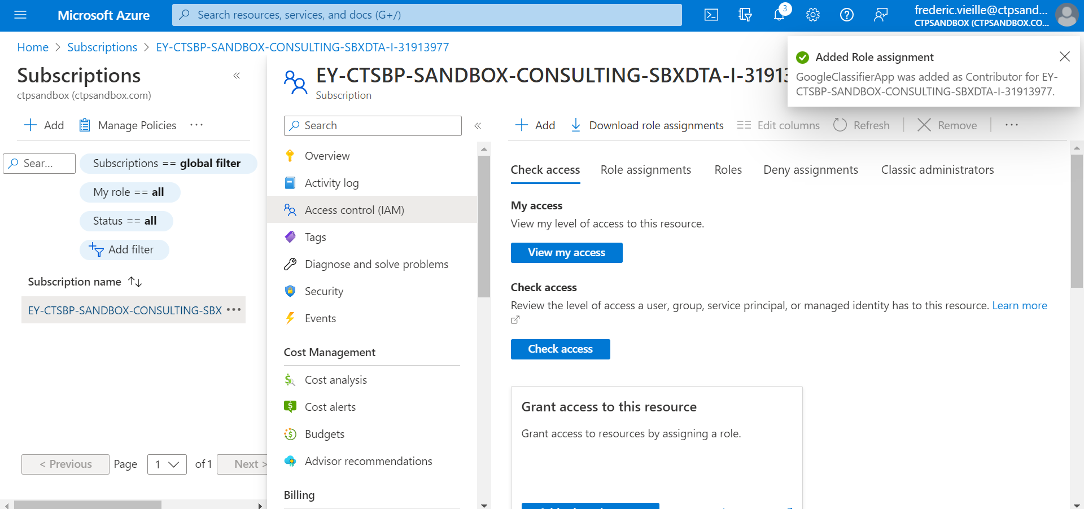
5- How to grant your Application registration
A notification will show on the right confirming the new added role assignment.

Slide 29
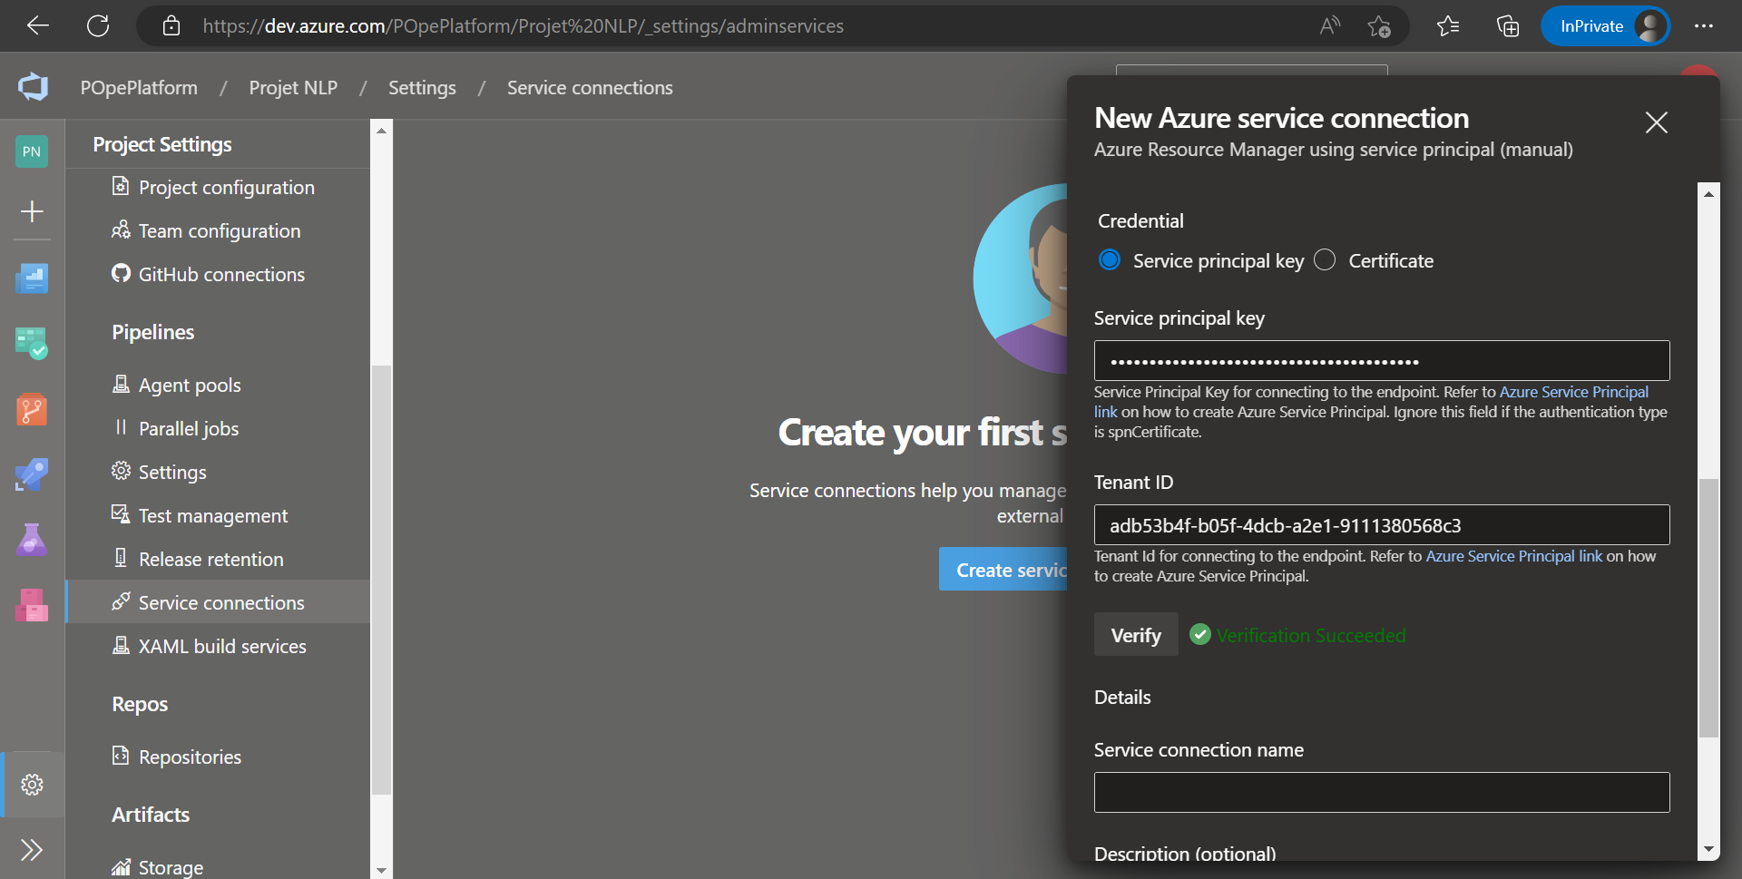
5- How to grant your Application registration
Go to your Azure DevOps form
Select Verify again
The verification will now be successful.

Slide 30
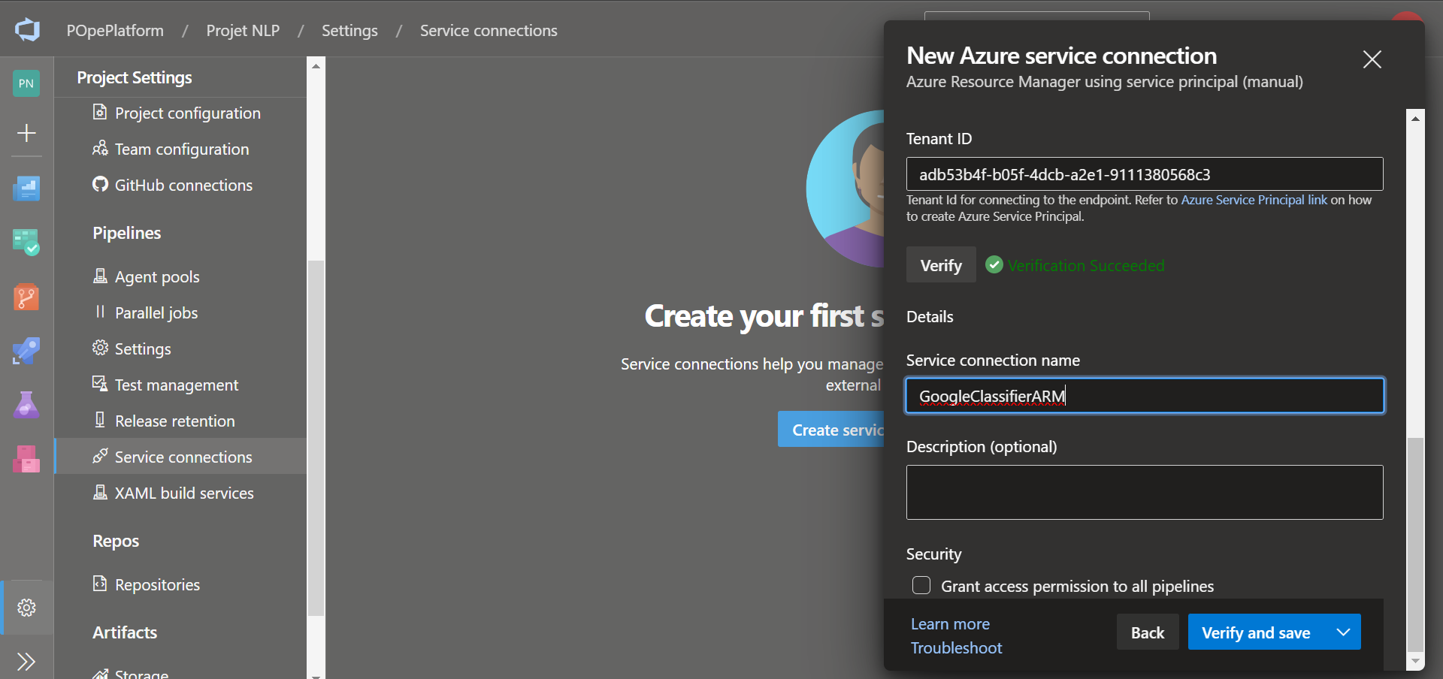
5- How to grant your Application registration
Enter a name for your new service connection under Service Connection name
Select Verify and save

Slide 31
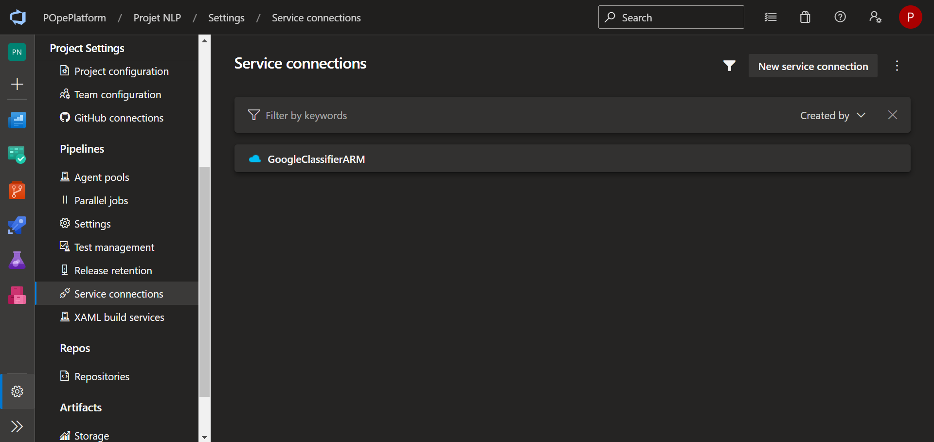
Ending
Congratulations ! You have finally created a azure connection.
This Azure Resource Manager connection will allow us to create a pipeline between your Azure DevOps project and your Azure Portal Sandbox environment.

